Slide 1
AI COLOURIZATION
USING OPEN CV PYTHON

Slide 2
Project presented by:
Aditya Kokate
Rashid Shaikh
Ajay Shirke
Sasmit Thakur
Guided by:
Prof. Amita Raman

Slide 3
INTRODUCTION
Image colorization is the process of adding color to grayscale images, making them visually appealing and realistic.
This project aims to leverage advanced machine learning techniques to automatically add color to black-and-white or grayscale images, thereby bringing them to life and evoking a sense of nostalgia and vibrancy.
This project aims to implement image colorization using the OpenCV library in Python.
OpenCV is a powerful computer vision library that provides tools and functions for image processing, making it an ideal choice for this task.

Slide 4
INTRODUCTION
The primary objective of this image colorization project is to develop an intelligent system that can analyze and interpret grayscale images, discern the objects and scenes within them, and accurately assign appropriate colors to different elements.
Gray scale image means the value of each pixel represents only the intensity information of the light.
Such images commonly display inly the darkest black to the brightest white.
The image carries only black, white and gray colors, in which gray has multiple levels.
Each pixel typically consists of 8 bits for gray scale images and there are 256 possible grayscale colors.
Why Image colourizations matters?
Historical Preservation
Enhanched Visual Experience
Artistic Expression

Slide 5
Literature Survey:
TITLE | YEAR OF PUBLICATION | AUTHOR | DESCRIPTION
“Image Colorization Based on Deep learning”[1] | 2023 | Tao Deng | This paper presents an interactive image colorization system that combines convolutional autoencoders with user guidance to improve colorization results.
“Deep Learning for the Automatic Colorization of Historical Aerial Images”[2] | 2022 | Elisa Farella | The article presents a new neural network architecture, Hyper-U-NET, which combines a U-NET-like architecture and HyperConnections to handle the colorization of historical black and white aerial images.
“Deep learning for image colorization: Current and future prospects”[3] | 2022 | Shanshan Huang | In this paper, a comprehensive review of recent DLIC approaches from algorithm classifications to existing challenges is provided to facilitate researchers’ in-depth understanding of DLIC

Slide 6
Literature Survey:
TITLE | YEAR OF PUBLICATION | AUTHOR | DESCRIPTION
"Image Colorization: A Survey and Dataset”[4] | 2020 | Saeed Anwar | This article presents a comprehensive survey of recent state-of-the-art deep learning-based image colorization techniques, describing their fundamental block architectures, inputs, optimizers, loss functions, training protocols, and training data etc.
“A Survey On Auto-Image Colorization Using Deep Learning Techniques With User Proposition”[5] | 2019 | C. Santhanakrishnan | An approach based on deep learning for automatic colorization of image with optional user-guided hints. The system maps a gray-scale image, along with, user hints” (selected colors) to an output colorization with a Convolution Neural Network (CNN).
“Colorization of black-and-white images using deep neural networks”[6] | 2018 | David Futschik | Our proposed method is a fully automated process. To implement it, we propose and compare two distinct convolutional neural network architectures trained under various loss functions.

Slide 7
PROBLEM STATEMENT
This project addresses the challenge of automatically adding colors to black and white or grayscale images, enhancing their visual appeal, and potentially making them more informative for various applications such as historical image restoration, artistic image enhancement, and computer vision tasks

Slide 8
ALGORITHM
Step 1: Import Necessary Libraries
Step 2: Define Paths to Model Files
Step 3: Argument Parsing
Step 4: Load the Pre-Trained Model
Step 5: Configure Model for AB channel Quantization
Step 6: Load and Pre-process the input image
Step 7: Colorize the image
Step 8: Covert LAB image to BGR and Post-Processing
Step 9: Display the results

Slide 9
FLOWCHART
START
Import Necessary Libraries
Define Paths to Model Files
Argument Parsing
Load the Pre-Trained Model
Configure Model for AB channel Quantization
Load and Pre-process the input image
Colorize the image
Covert LAB image to BGR and Post-Processing
Display the results

Slide 10
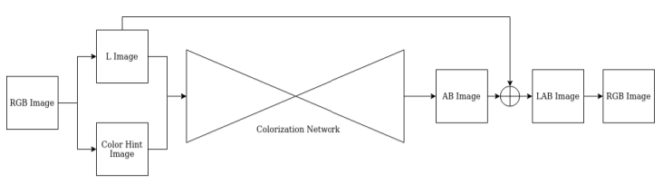
BLOCK DIAGRAM

Slide 11
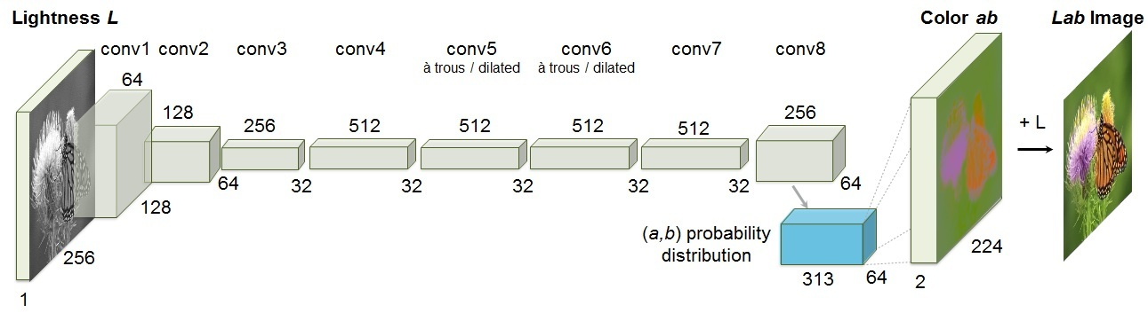
COLORIZATION PROCESS

Slide 12
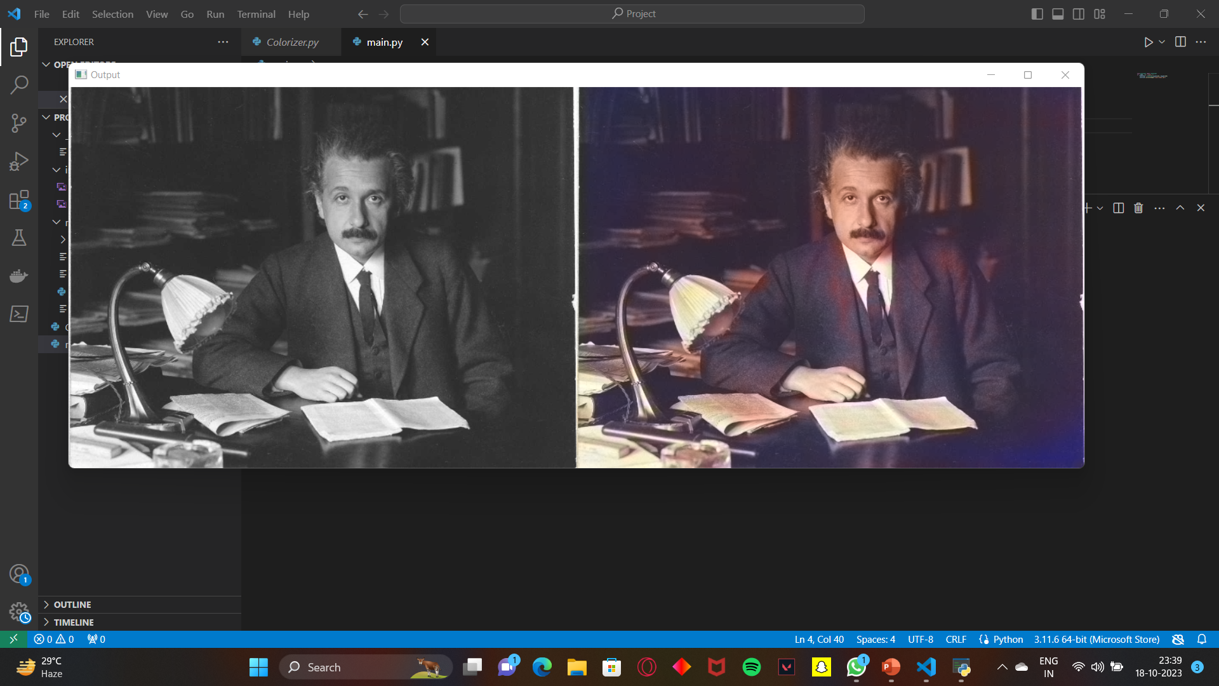
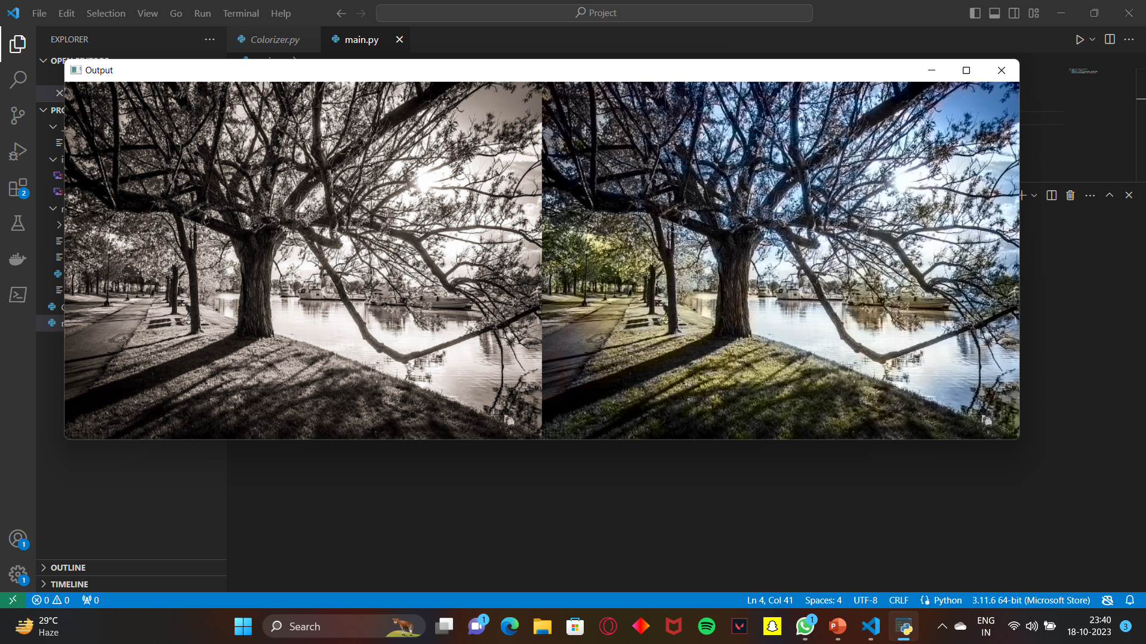
PROJECT OUTPUT

Slide 13
CONCLUSION
We have finally completed 100% of our project and during this period we have gone through various colorization sites and through many online references.
We have unlighten ourself through various python libraries, its uses and how to implement them in the desired code.
Initially, we were facing errors due to missing python libraries but by references and guidance we have resolved them.
So after resolving all the errors, we have successfully achieved the output of our project.

Slide 14
REFERENCE
[1] “Image Colorization Based on Deep learning” - Tao Deng (2023)
[2] “Deep Learning for the Automatic Colorization of Historical Aerial Images” - Elisa Farella (2022)
[3] “Deep learning for image colorization: Current and future prospects” - Shanshan Huang (2022)
[4] "Image Colorization: A Survey and Dataset” - Saeed Anwar (2020)
[5] “A Survey On Auto-Image Colorization Using Deep Learning Techniques With User Proposition” - C. Santhanakrishnan (2019)
[6] “Colorization of black-and-white images using deep neural networks” - David Futschik (2018)
[7] Iizuka, Satoshi, Edgar Simo-Serra, and Hiroshi Ishikawa. "Let there be color!: joint end-to-end learning of global and local image priors for automatic image colorization with simultaneous classification." ACM Transactions on Graphics (TOG) 35.4 (2016).
[8] Cheng, Zezhou, Qingxiong Yang, and Bin Sheng. "Deep colorization." Proceedings of the IEEE International Conference on Computer Vision. 2015.
[9] Larsson, Gustav, Michael Maire, and Gregory Shakhnarovich. "Learning representations for automatic colorization." European Conference on Computer Vision. Springer, Cham, 2016.
[10] Li, Bo, et al. "Depth and surface normal estimation from monocular images using regression on deep features and hierarchical CRFs." Proceedings of the IEEE Conference on Computer Vision and Pattern Recognition. 2015.
[11] Zhang, Richard, et al. "Real-time user-guided image colorization with learned deep priors." arXiv preprint arXiv:1705.02999 (2017).
[12] Deshpande, Aditya, Jason Rock, and David Forsyth. "Learning large-scale automatic image colorization." Proceedings of the IEEE International Conference on Computer Vision. 2015.
[13] Limmer, Matthias, and Hendrik PA Lensch. "Infrared colorization using deep convolutional neural networks." Machine Learning and Applications (ICMLA), 2016 15th IEEE International Conference on. IEEE, 2016.

Slide 15
THANKYOU

